Slide 1

Insights
Module 1 Week-1

Slide 2
Agenda
SOLID Code Walkthrough
Messenger Design
Microservices

Slide 3
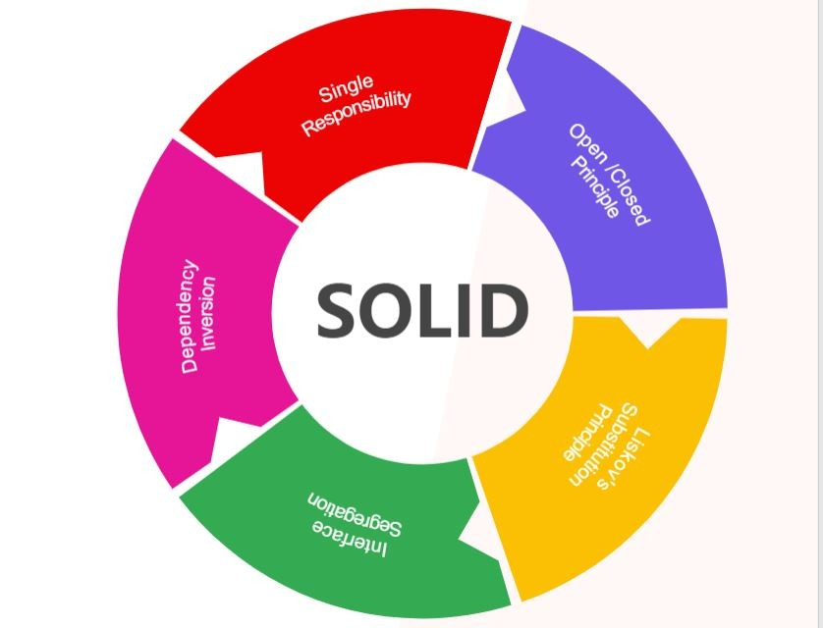
SOLID

Slide 4
SOLID Code Walkthrough
Before Applying SOLID
After Applying SOLID

Slide 5
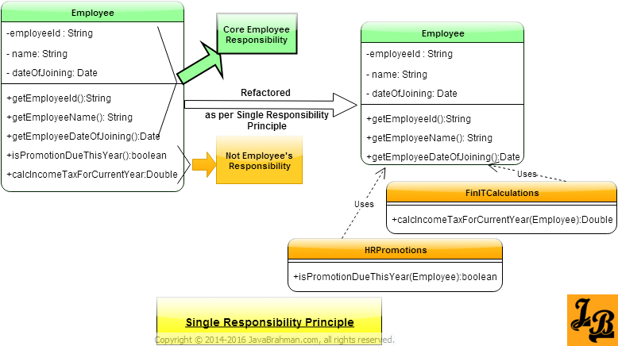
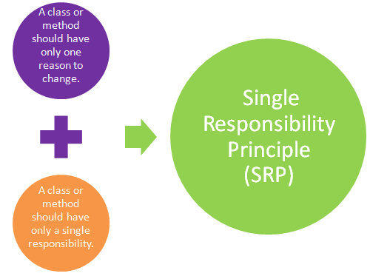
SRP

Slide 6
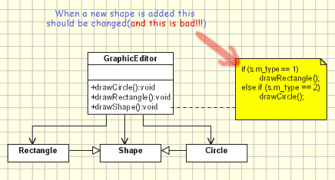
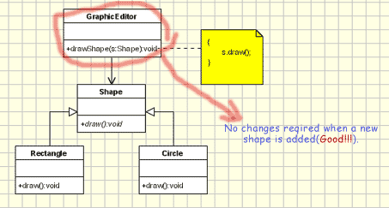
OCP

Slide 7
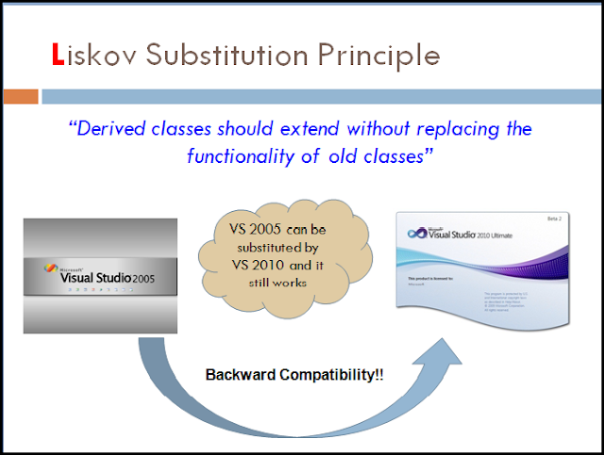
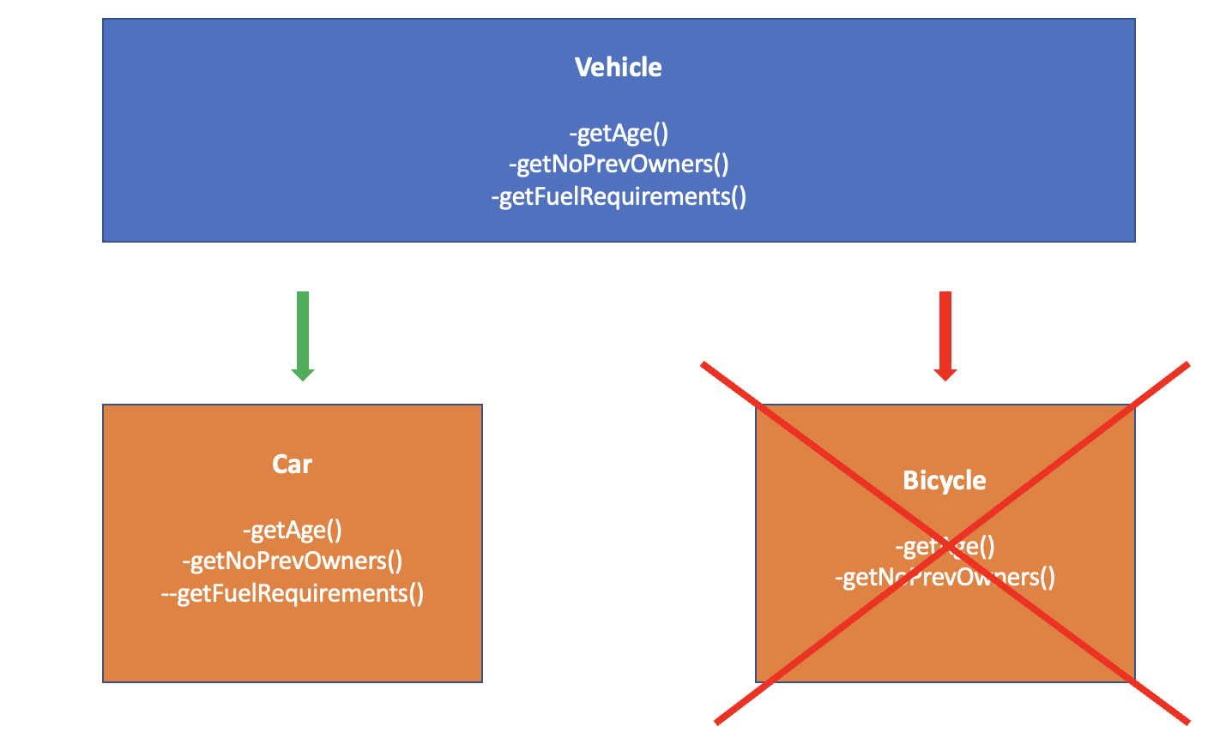
Liskov

Slide 8
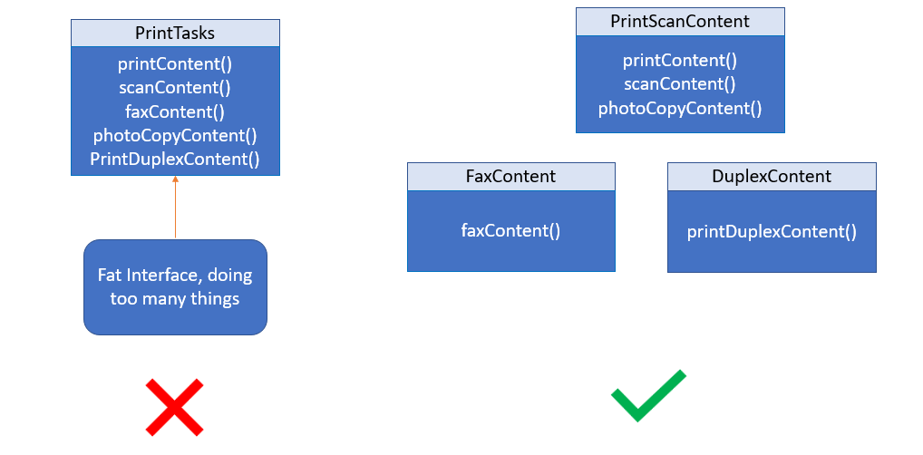
ISP

Slide 9
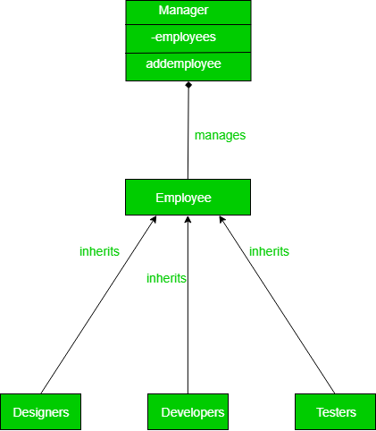
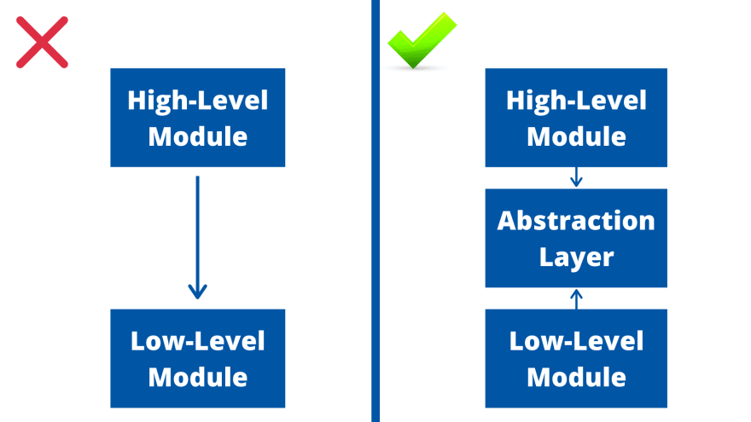
DIP

Slide 10
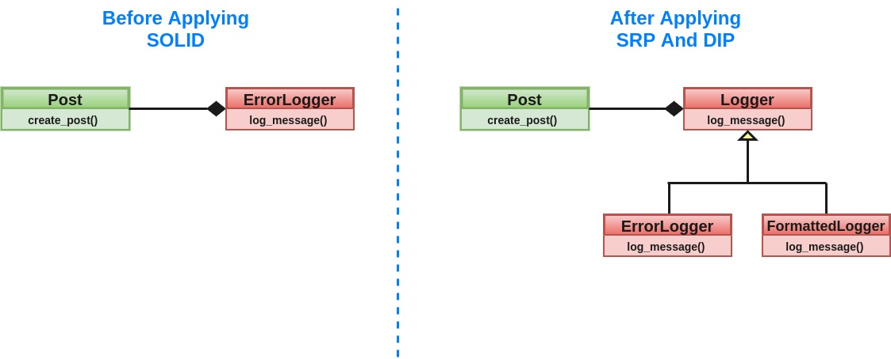
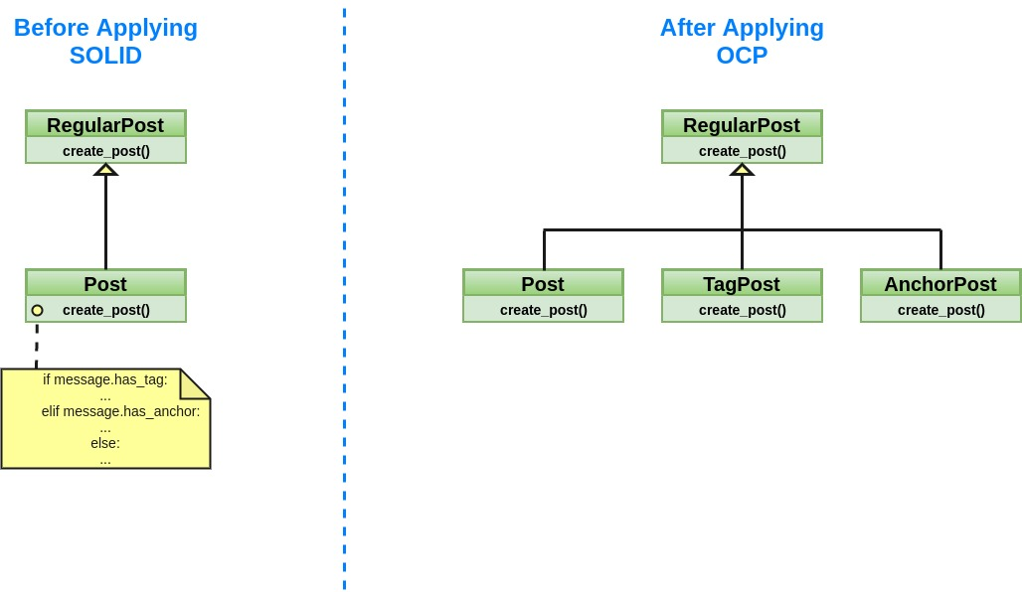
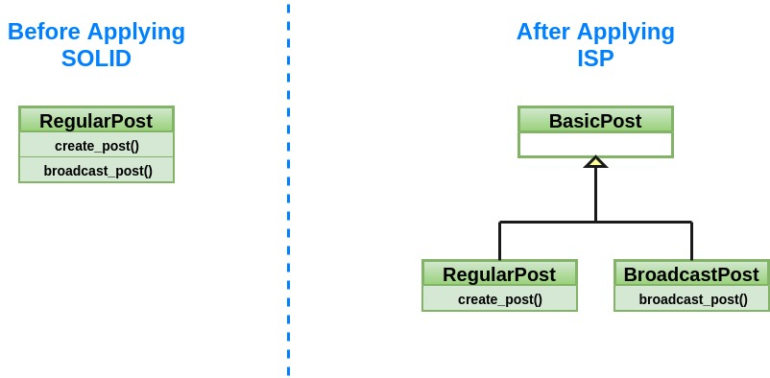
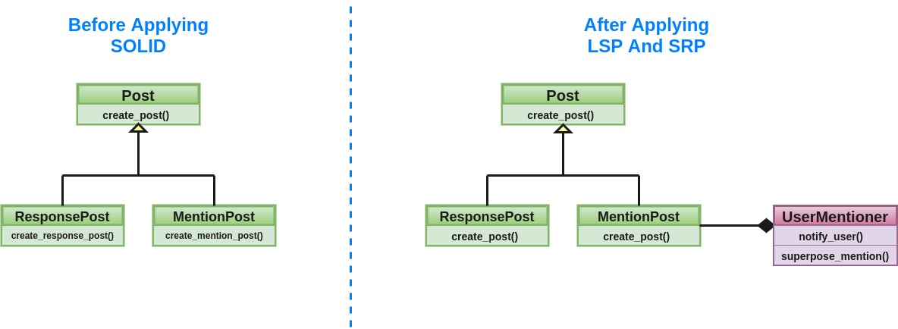
Messenger Code Walkthrough

Slide 11
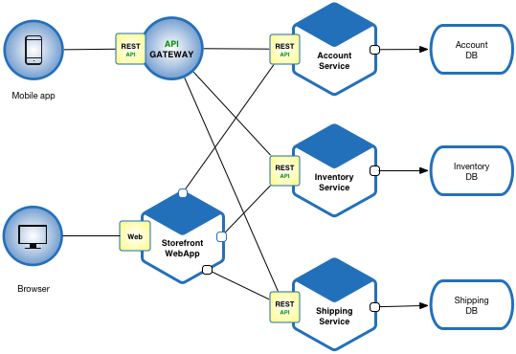
Microservice Design

Slide 12
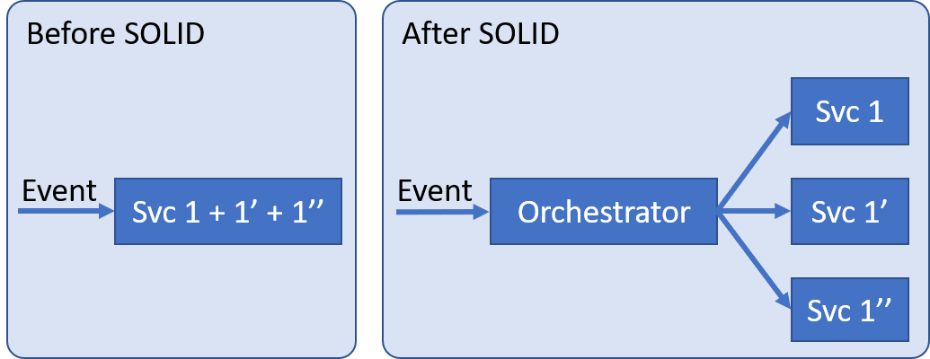
SRP
Order in which services needs to be called is the responsibility of an orchestrator.

Slide 13
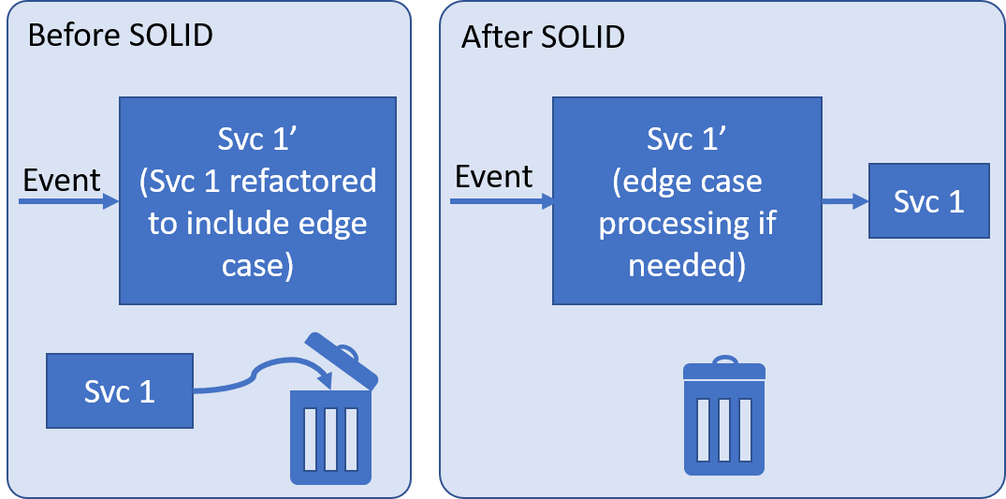
OCP

Slide 14
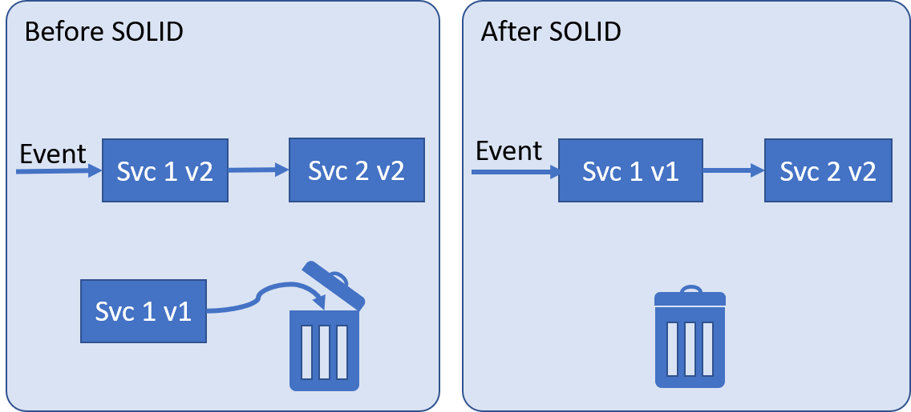
LSP
Base Contracts
are honored.

Slide 15
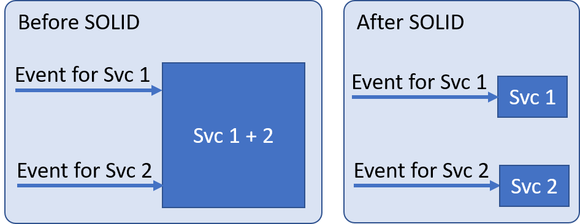
ISP
Billing and Payment
Billing
Payment

Slide 16
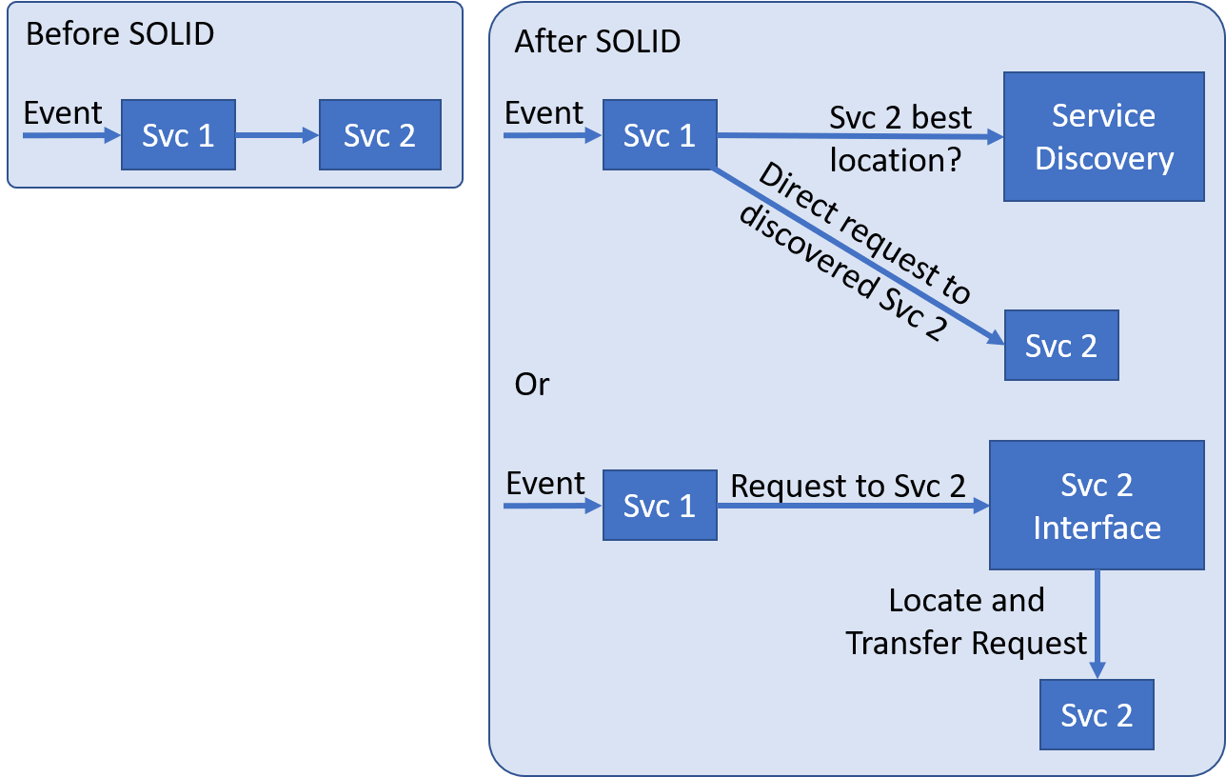

Slide 17
References
https://www.baeldung.com/solid-principles
https://www.tutorialspoint.com/object_oriented_analysis_design/ooad_uml_basic_notation.htm
https://fi.ort.edu.uy/innovaportal/file/2032/1/design_principles.pdf
https://www.educative.io/courses/web-application-software-architecture-101/qADAzX6yorR
https://microservices.io/
https://microservices.io/refactoring/
https://github.com/Netflix/eureka/wiki/Running-the-Demo-Application

